Slide 1
Big Mountain Resort
Ticket Prices Project
Hande Gulbagci Dede
2/11/2022

Slide 2
Problem Statement
New chair lift increases the operating costs by $1,540,000
Suspicion of underutilization of facilities
Deciding the most effective ticket prices
What is the best pricing model for Big Mountain Resort tickets considering the number and property of resort facilities?

Slide 3
Key Findings and Recommendations
Our modelled ticket price is $98.48.
Ticket prices can be close to high segment in market.
Building new facilities for increase the income
  Runs, vertical drop, chair lift
Cutting costs
  Closing the some of runs
Think about marketing strategy because of increasing ticket price

Slide 4
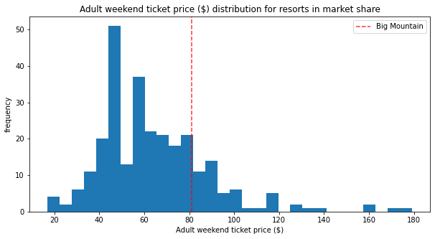
Results
Best model is the random forest model
The actual price is $81.00.
  Above the market average.
  The first in the state.
Our modelled price is $98.48.
Expected mean absolute error of $10.31.
There is room for increase.

Slide 5
Results
The facilities of Big Montana support the ticket price increase.
According to our model, there are four important features:
  the number of fast four person chairs ,
  count of the number of runs,
  the area covered by snow making machines,
  vertical change in elevation from the summit to the base.
The Big Montana is amongst the highest according to many important features.
Above the market average.

Slide 6
Results
Assumptions:
  Expected number of visitors over the season is 350,000,
  The average resort stay is 5 days.
Building new facilities
  Adding a run, increasing the vertical drop by 150 feet, and installing an additional chair lift increases income to $3,888,889
Cutting cost
  Closing the 5 runs can be considered as an option to reduce the expenses, the ticket prices decrease between $1.50-$2.00.
The building and operating costs should be taken into account.

Slide 7
Summary and Conclusion
Increasing the ticket prices is safe for resort.
The resort's facilities support the increase.
Considering the marketing strategy because of increased ticket prices.

